Slide 1
The Importance of Christian Ethics
Conduct and Lifestyle
So that you may know how you ought to conduct yourself in the house of God, which is the church of the Living God, the pillar and ground of the truth. 1 Timothy 3:14-15
Ethical practices are upright, honorable, moral, lawful and full of integrity)

Slide 2
The Battle of the
Flesh and Spirit
For the flesh lusteth against the Spirit, and the Spirit against the flesh: and these are contrary the one to the other: so that ye cannot do the things that ye would.
Galatians 5:17

Slide 3
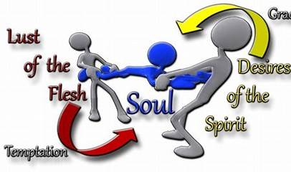
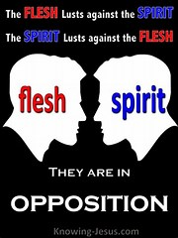
Desires of the Flesh
1
2
3
Lust of the flesh
Lust of the eyes
The
Pride of
Life
Seeks to find fulfillment and purpose in that which can never give fulfillment or purpose
Being distracted or captivated by outward appearances without looking at the real value.
An attitude of arrogance based on the false confidence in wealth, achievement or status in society.
John 5:16: “For all that are in the world, the lust of the flesh, the lust of the eyes, and the pride of life, are not of the Father, but are of the world. The world passes away, and the lust thereof, but he that doeth the will of God abides forever.”

Slide 4
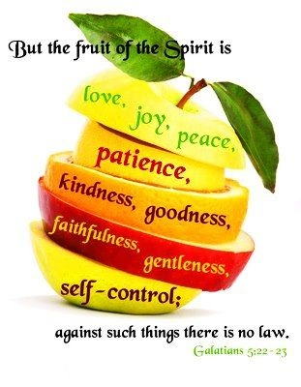
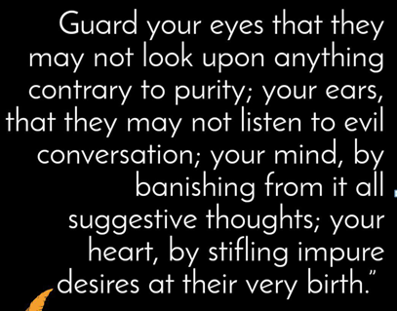
1
MIND
2
EYES
3
EARS
4
HEART
[This] I say then, Walk in the Spirit, and ye shall not fulfill the lust of the flesh. Galatians 5:16 KJV:
If we live by the Spirit, let us also walk by the Spirit. Galatians 5:25

Slide 5
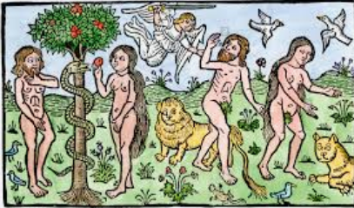
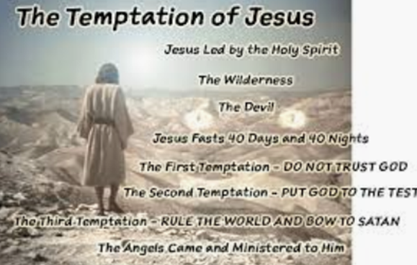
Yielding to the Satan
Jesus used the Word of God against Satan

Slide 6
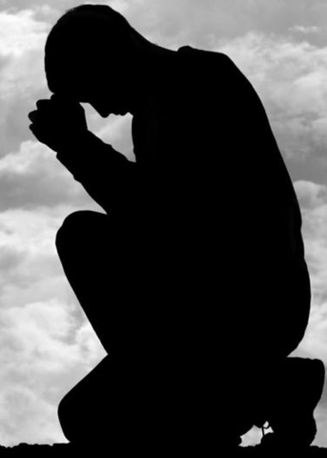
INTEGRITY
GENEROSITY
HUMILITY
Parameters to build ministry
Integrity is the antidote for the lust of the flesh.
A leader has to put boundaries in their lives to keep it pure
Generosity is the only antidote for the lust of the eyes or materialism.
Humility is the antidote for a proud spirit. Humility is recognizing your dependence on God

Slide 7
Ethics is a prerequisite for Christian Ministry
Conduct and Lifestyle
God looks at your heart and knows if you believe Him or not. The world doesn’t see our hearts, they just us by our works or the fruit of our faith!
Be ye doers of the Word, and not hearers only,
deceiving your own selves. James 1:22

